Slide 1
Database Management
Kelly Rossa Sungkono

Slide 2

Agenda
Review Last Exercise
Data Definition Language
Data Manipulation Language

Slide 3
Review of Data Modelling
Review Last Exercise

Slide 4
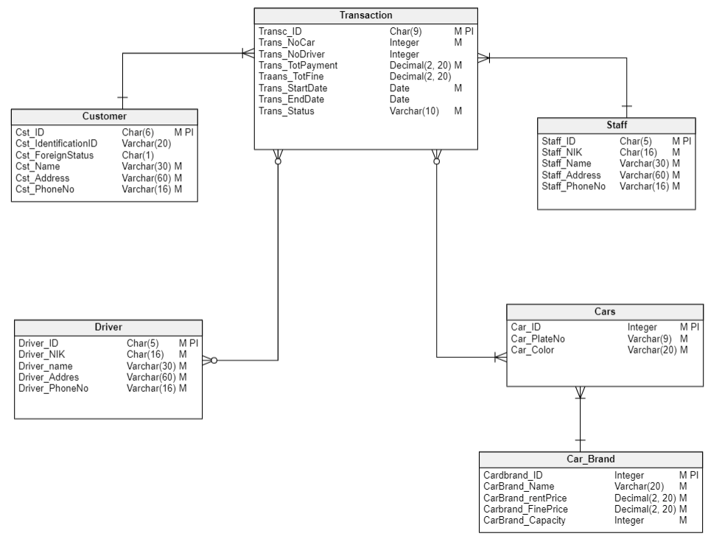
Review of Data Modelling
CDM
Format decimal in Vertabelo :
Decimal(Scale, Precision)
Common format decimal :
Decimal(Precision,Scale)
Precision : digits in a number
Scale : digits to the right of decimal point in a number
Example :
5000.00 => Precision 6 Scale 2

Slide 5
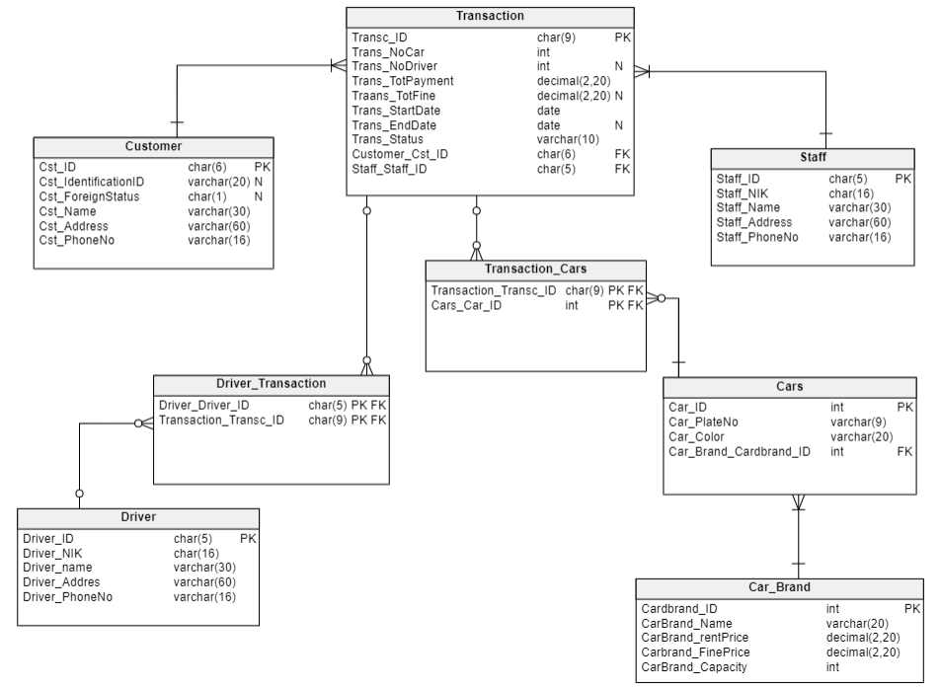
Review of Data Modelling
PDM

Slide 6
Review of Data Modelling
Data Definition Language (DDL)

Slide 7
Data Definition Language (DDL)
Data Definition Language (DDL) is the language in the DBMS that is used to create or define objects in the database.
Generally used to create objects in tables and views.

Slide 8
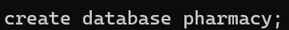
DDL for create Database
Syntax : create database <nameOfDatabase>;
Example: Create database named “pharmacy”

Slide 9
DDL for create Table
CREATE TABLES
Used to create tables and their attributes (columns)
ALTER TABLES
Used to add, delete and change attributes (columns) in a table
DROP TABLES
Used to delete a table

Slide 10


DDL for create Table
Example: Create Table Medicine Type in Database Pharmacy

Slide 11
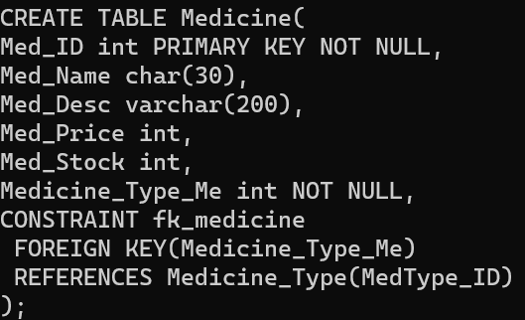
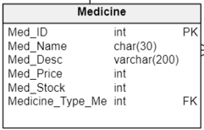
DDL for create Table
Example: Create Table Medicine in Database Pharmacy
Define the column for Foreign key and add constraint foreign key

Slide 12
DDL for alter Table
Alter table can be used for:
Add column
Modify column
Drop column

Slide 13

DDL for alter Table – Add Column
Syntax :
Alter Table table_name
Add column_name datatype;
Example: add column “MedType_Desc” in Medicine Type Table

Slide 14

DDL for alter Table – Modify Column (Datatype)
Syntax :
Alter Table table_name
Alter Column column_name Type datatype;
Example: modify datatype column “MedType_Desc” to varchar(300)

Slide 15

DDL for alter Table – Modify Column (Rename Column)
Syntax :
Alter Table table_name
Rename Column column_name To datatype;
Example: modify name column “MedType_Desc” to “MedicineType_Desc”

Slide 16

DDL for alter Table – Drop Column
Syntax :
Alter Table table_name
Drop Column column_name;
Example: drop column “MedicineType_Desc”

Slide 17
Review of Data Modelling
Data Manipulation Language (DML)

Slide 18
Data Manipulation Language
DML (Data Manipulation Language ) → SQL language used to manipulate data in a table.
DML commands include:
INSERT – Insert/add new data into tables in the database
UPDATE – Updating data in tables in the database
DELETE – Delete data from tables in the database
SELECT – Extract/display data from tables in the database

Slide 19
INSERT
Used to ADD new data
Syntax :
Insert Into table_name [col_1,….,col_n]
Values (value_col_1,…,value_col_n);
Note:
The part inside the brackets is optional
table_name is the name of the table whose data will be manipulated
col_1 etc. are the column names of the table
If data is to be filled in all the columns (fields) of a table, then it is not necessary to mention the column names, but the fields must be entered in order.
If the data will only be filled in to certain columns (fields), the column names must be mentioned.

Slide 20
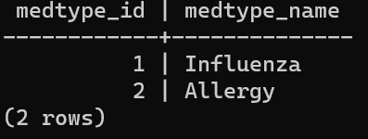
INSERT
Example:
Result

Slide 21
UPDATE
Syntax :
Update table_name Set col_name=value
[Where condition];
Used to change or update data
Note:
Table_name contains the name of the table where the data to be modified is located.
Col_name contains the name of the column where the column of data is located.
Value is the replacement data value to be entered
Condition are the conditions of the data to be changed.

Slide 22
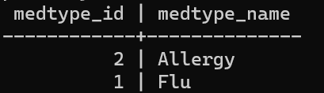
UPDATE
Result

Slide 23
Perintah DELETE
Used to delete data
Syntax :
Delete From table_name
[Where condition];
Note:
Table_name contains the name of the table where the data to be deleted is located.
Condition are the conditions of the data to be deleted.

Slide 24

DELETE
Result

Slide 25
SELECT
SELECT [DISTINCT] select_list
FROM table_source
[WHERE search_condition]
[GROUP BY group_by_expression]
[HAVING search_condition]
[ORDER BY order_expression [ASC | DESC] ]

Slide 26
Please insert the data below by using INSERT syntax:
Table: Medicine_Type
Table: Medicine
Medtype_ID | MedType_Name
1 | Flu
2 | Allergy
Med_ID | Med_Name | Med_Desc | Med_Price | Med_Stock | Medicine_Type_Me
1 | Panadol | Panadol is flu medicine containing Paracetamol | 12000 | 30 | 1
2 | Vicks | Vicks is a cough syrup | 17000 | 40 | 1
3 | OBH Combi | OBH Combi is flu medicine containing OBH | 16000 | 10 | 1
4 | Loratadine | Loratadine is for allergy symptoms such as hay fever | 5800 | 20 | 2
5 | Claritin | Claritin is for allergy symptoms such as hay fever | 72000 | 10 | 2

Slide 27
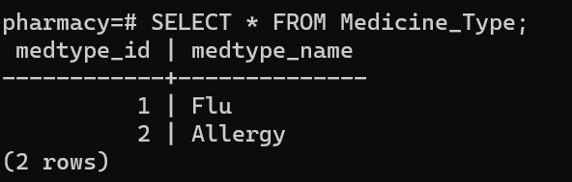
SELECT
Example: Select data in Table “Medicine_Type”

Slide 28
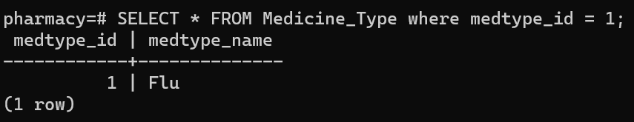
SELECT
Example: Select data in Table “Medicine_Type” where ID = 1

Slide 29
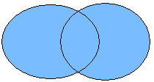
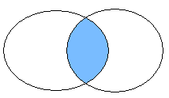
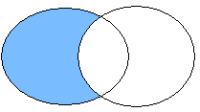
UNION, INTERSECT dan EXCEPT
UNION
INTERSECTION
EXCEPTS
A
B
A
B
A
B

Slide 30
UNION
𝐴∪𝐵 returns a relation instance that contains all tuples that satisfy relation instance A or relation instance B
A and B must be union-compatible
Two relation instances are said to be union-compatible, if:
Both have the same number of fields (columns), and
Related fields, from left to right, have the same domain

Slide 31
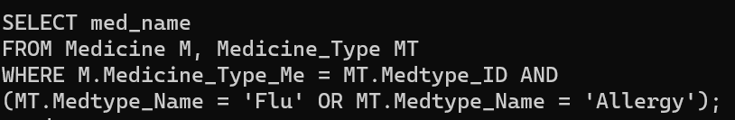
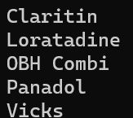
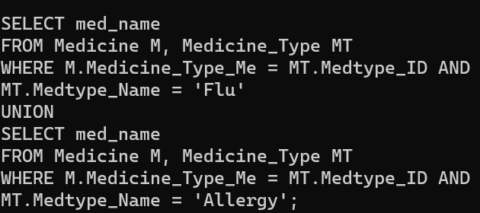
UNION
Example: Show name of medicines which are classified as flu-type OR allergy-type
Result

Slide 32
INTERSECTION
𝐴∩𝐵 returns a relation instance that contains all tuples that satisfy relation instance A and relation instance B
Relations A and B must be union-compatible

Slide 33
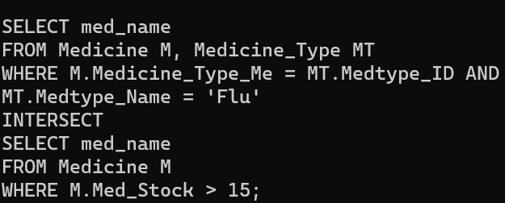
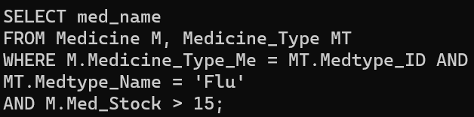

INTERSECTION
Example: Show name of medicines which are classified as flu-type AND the stock > 15
Result

Slide 34
EXCEPT
𝐴−𝐵 returns a relation instance that contains all the tuples that are in relation instance A, but not in relation instance B

Slide 35
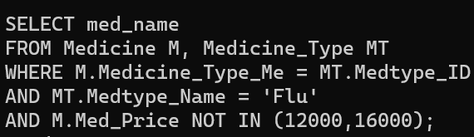
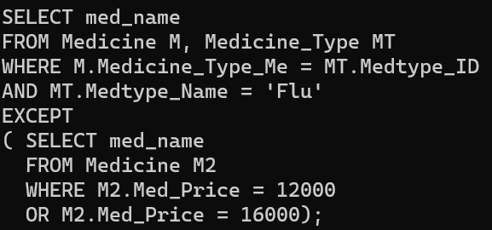

EXCEPT
Example: Show the name of flu medicine which costs not in (12000 or 16000).
Result

Slide 36
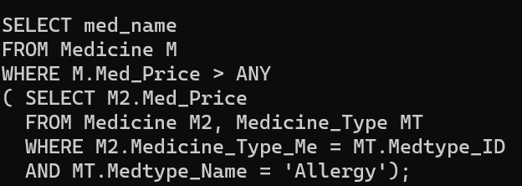
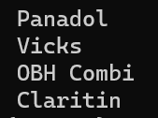
SET OPERATIONS - ANY
Example: Show the name of medicines that cost more than some allergy-type medicine price

Slide 37
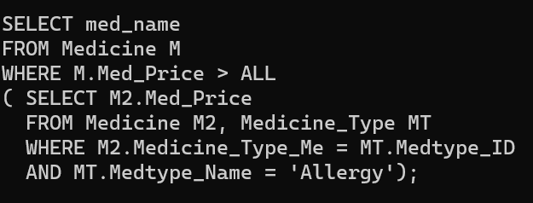
SET OPERATIONS - ALL
Example: Show the name of medicines that cost more than every price of allergy-type medicine
No Result because there is no medicine costs more than allergy-type medicine: Claritin

Slide 38
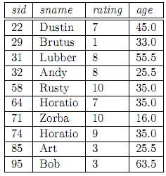
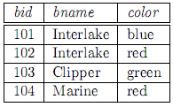
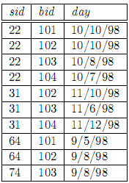
Individual Task
Database ‘Boat Rental’ Scheme:
Sailors(sid: integer, sname: varchar(10), rating: integer, age: decimal(4,1))
Boats(bid: integer, bname: varchar(10), color: varchar(10))
Reserves(sid: integer, bid: integer, day: date). The format of day is Month/Day/Year

Slide 39
Individual Task
Create database ‘Boat Rental’ and its tables based on the Scheme
Insert the data based on the Scheme
Select the name and sid of Sailor who has a 35 years old
Select the name of Sailor who has rating more than 5
Select the sid, bid and day from table Reserves in October
Select the name of Sailor who borrowed Red and Green Boats
Select the name of Sailor who borrowed Red or Green Boats
Select the name of Sailor who borrowed Red but not borrowed Green Boat

